Slide 1
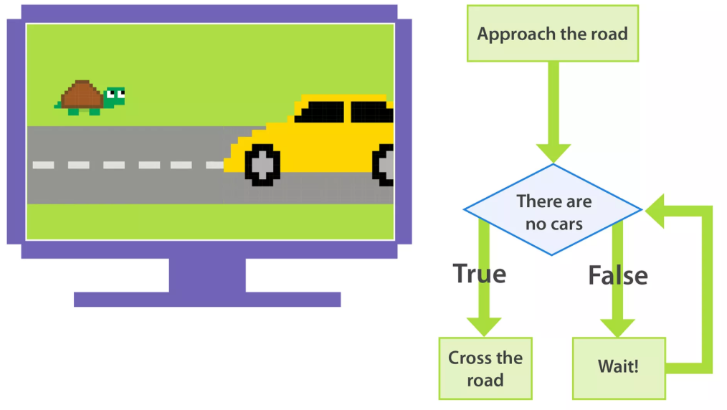
Loops

Slide 2

Image source

Slide 3
TO print or NOT TO print that is the question? Prince Hamlet (Did I say it?)
What if someone asks you to print 'Hello World' 10 times?
One way is to write the print statement 10 times.
But that is definitely not a good choice if you have to write it 50 or 50000 times!
So, simply loop ☺

Slide 4
Topics
while statement
for statement
break statement
continue statement
Nested loops

Slide 5
while loop
Implements the repetition in an algorithm
Repeatedly executes a block of statements
Tests a condition (Boolean expression) at the start of each iteration
Terminates when condition becomes False

Slide 6

Print Bart’s sentence 10 times
count=1
while count <= 10:
print('Go to statement considered harmful')
count = count + 1
Go to statement considered harmful
Go to statement considered harmful
Go to statement considered harmful
Go to statement considered harmful
Go to statement considered harmful
Go to statement considered harmful
Go to statement considered harmful
Go to statement considered harmful
Go to statement considered harmful
Go to statement considered harmful

Slide 7

Learn more about while
Now, let's understand each line of the code.
First, have a look at the syntax of a while loop.
while condition:
statement(s)
While loop checks whether the condition is True or not.
If the condition is True, then statements written in the body of the while loop are executed.
Then, again the condition is checked, and if found True then statements in the body of the while loop are executed again.
This process continues until the condition becomes False.

Slide 8

Learn more about while
For a better understanding, let's consider our example step by step.
In our example, firstly, we assigned a value 1 to a variable count.
while count <= 10 checks the condition ‘count <= 10'. Since the value of count is 1 which is less than 10, the statements within the body(indented part) are executed.
'Go to statement considered harmful' is printed and the value of ‘count’ is incremented by 1. So, now the value of ‘count' becomes 2.

Slide 9

Learn more about while
Now, again the condition is checked. This time also ‘count <= 10' is true because the value of ‘count' is 2. So, again 'Go to statement considered harmful' is printed and the value of ‘count' increased to 3.
When the value of ‘count' becomes 10, again the condition ‘count <= 10' is true and 'Go to statement considered harmful' is printed for the tenth time. Now, count is incremented by 1 and the value is 11.
This time, the condition ‘count <= 10' becomes False and the while loop terminates.
Wasn't that interesting?

Slide 10
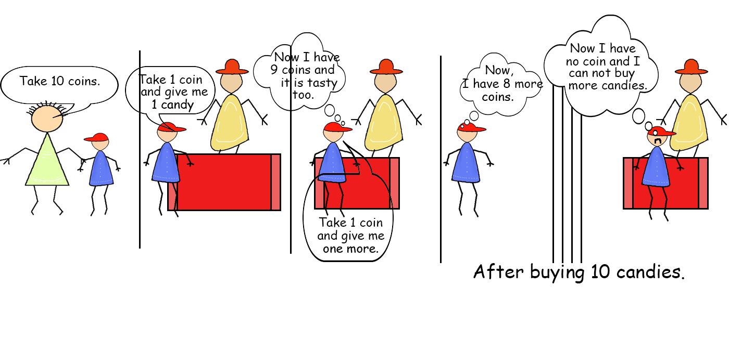

Slide 11
Useful Notations
If LHS of assignment is in RHS of an expression we can shorten
sum=0
sum+=number ➔sum=sum+number
sum-=number ➔sum=sum-number
sum*=number ➔sum=sum*number
sum/=number ➔sum=sum/number

Slide 12
Example: addnum
Read in numbers, add them, and
print their sum and average
set sum to 0
set count to 0
input total_numbers
while count < total_numbers
input next_num
add next_num to sum
add 1 to count
output "Sum was" sum
output "Mean was" sum/count

Slide 13
Example: addnum (cont)
Read in numbers, add them, and
print their sum and average
set sum to 0
set count to 0
input total_numbers
while count < total_numbers
input next_num
add next_num to sum
add 1 to count
output "Sum was" sum
output "Mean was" sum/count
Iteration Control
Initialize
Check condition
Update

Slide 14
Example: addnum (cont)
'''
Read in numbers and add them up
Print out the sum and the average
'''
sum = 0.0
count = 0
total_numbers=int(input('How many numbers: '))
while count < total_numbers:
next_num=float(input('Next number: '))
sum += next_num
count += 1
print("Sum was %f” %sum)
print("Mean was %f” %(sum/count))

Slide 15
Example: addnum (cont)
sum = 0.0
count = 0
total_numbers=int(input('How many numbers: '))
while count < total_numbers:
next_num=float(input('Next number: '))
sum += next_num
count += 1
print("Sum was %f” %sum)
print("Mean was %f” %(sum/count))
total_numbers | count | next_num | sum
???? | 0 | ???? | 0.0

Slide 16
Example: addnum (cont)
sum = 0.0
count = 0
total_numbers=int(input('How many numbers: '))
while count < total_numbers:
next_num=float(input('Next number: '))
sum += next_num
count += 1
print("Sum was %f” %sum)
print("Mean was %f” %(sum/count))
total_numbers | count | next_num | sum
???? | 0 | ???? | 0.0
3
How many numbers: 3

Slide 17
Example: addnum (cont)
sum = 0.0
count = 0
total_numbers=int(input('How many numbers: '))
while count < total_numbers:
next_num=float(input('Next number: '))
sum += next_num
count += 1
print("Sum was %f” %sum)
print("Mean was %f” %(sum/count))
total_numbers | count | next_num | sum
???? | 0 | ???? | 0.0
3 | 1 | 2.3 | 2.3
How many numbers: 3
Next number: 2.3

Slide 18
Example: addnum (cont)
sum = 0.0
count = 0
total_numbers=int(input('How many numbers: '))
while count < total_numbers:
next_num=float(input('Next number: '))
sum += next_num
count += 1
print("Sum was %f” %sum)
print("Mean was %f” %(sum/count))
total_numbers | count | next_num | sum
???? | 0 | ???? | 0.0
3 | 2 | 4.5 | 6.8
How many numbers: 3
Next number: 2.3
Next number: 4.5

Slide 19
Example: addnum (cont)
sum = 0.0
count = 0
total_numbers=int(input('How many numbers: '))
while count < total_numbers:
next_num=float(input('Next number: '))
sum += next_num
count += 1
print("Sum was %f” %sum)
print("Mean was %f” %(sum/count))
total_numbers | count | next_num | sum
???? | 0 | ???? | 0.0
3 | 3 | 4.5 | 11.3
How many numbers: 3
Next number: 2.3
Next number: 4.5
Next number: 4.5

Slide 20
Example: addnum (cont)
sum = 0.0
count = 0
total_numbers=int(input('How many numbers: '))
while count < total_numbers:
next_num=float(input('Next number: '))
sum += next_num
count += 1
print("Sum was %f” %sum)
print("Mean was %f” %(sum/count))
total_numbers | count | next_num | sum
???? | 0 | ???? | 0.0
3 | 3 | 4.5 | 11.3
How many numbers: 3
Next number: 2.3
Next number: 4.5
Next number: 4.5
Sum was 11.300000
Mean was 3.766667

Slide 21
Input x (int) print all numbers from 0 to x
count = 0
x=int(input('x = '))
while count <= x:
print(count)
count += 1
x = 5
0
1
2
3
4
5

Slide 22
Input x (int) print all numbers from x to 0
x=int(input('x = ‘))
count = x
while count >= 0:
print(count)
count -= 1
x = 5
5
4
3
2
1
0

Slide 23
Input x (int ) print all even numbers from 0 to x
x=int(input('x = '))
count = 0
while count <= x:
print(count)
count += 2
x = 5
0
2
4

Slide 24
Input x (int ) print all even numbers from x to 0
x=int(input('x = '))
count = x
if x % 2 == 1:
count = x-1 #or count-1
while count >= 0:
print(count)
count -= 2
x = 5
4
2
0

Slide 25
Input x (int ) print all odd numbers from 0 to x
x=int(input('x = '))
count = 1
while count <= x:
print(count)
count += 2
x = 5
1
3
5

Slide 26
Input x (int ) print all odd numbers from x to 0
x=int(input('x = '))
count = x
if x % 2 == 0:
count = x-1 #or count-1
while count >= 0:
print(count)
count -= 2
x = 5
4
2
0

Slide 27
print('0 to 5')
i=0
while i<5:
print(i)
i=i+1
print('0 to 5 even')
i=0
while i<5:
print(i)
i=i+2
print('1 to 5 odd')
i=1
while i<5:
print(i)
i=i+2
print('0 to 5 even with if')
i=0
while i<5:
if i%2==0:
print(i)
i=i+1
print('Down to\n 5 to 0')
i=5
while i>=0:
print(i)
i=i-1
print('5 to 0 even')
i=4
while i>=0:
print(i)
i=i-2
print('5 to 0 odd')
i=5
while i>=0:
print(i)
i=i-2
print('5 to 0 even with if')
i=5
while i>=0:
if i%2==0:
print(i)
i=i-1

Slide 28
Input x (int) print x stars ***...*
count = 1
x=int(input('x = '))
while count <= x:
print('*',end='')
count += 1
x = 5
*****

Slide 29
Input 100 numbers. Count the even numbers
even_count = 0
number_count = 0
how_many = 5 #can change to 100
while number_count < how_many:
x = int(input())
number_count += 1
if x % 2 == 0:
even_count += 1
print(even_count, 'even numbers')
5
6
7
8
0
3 even numbers

Slide 30
Input 100 numbers. Check if 20 is among them

Slide 31
Input n (int) calculate n!
n! =n x (n-1) x (n-2) x … 2 x 1

Slide 32
for loop
for loop iterates over an enumeration of a set of items.
It is usually characterized by the use of an implicit or explicit iterator.
In each iteration step a loop variable is set to a value in a sequence or other data collection.

Slide 33
for loop
Steps through the items of
lists,
tuples,
strings,
the keys of dictionaries
ranges and
other iterables.

Slide 34

for loop
The Python for loop
starts with the keyword "for"
followed by an arbitrary variable name, which will hold the values of the following sequence object, which is stepped through.
The items of the sequence object are assigned one after the other to the loop variable; the variable points to the items.
For each item the loop body is executed.
The general syntax looks like this: for <variable> in <sequence>:
<statements>
else:
<statements>

Slide 35
Counting with for
print('1 to 5')
for x in [1,2,3,4,5]:
print(x)
print('5 to 1')
for x in [5,4,3,2,1]:
print(x)
1 to 5
1
2
3
4
5
5 to 1
5
4
3
2
1

Slide 36
range()
The range() function returns a sequence of numbers, starting from 0 by default, and increments by 1 (by default), and ends at a specified number.
range(start, end, modify)
range(3) ➔[0,1,2]
range(1,3) ➔[1,2]
range(1,5,2) ➔[1,3]
range(5,0,-2)➔[5,3,1]

Slide 37
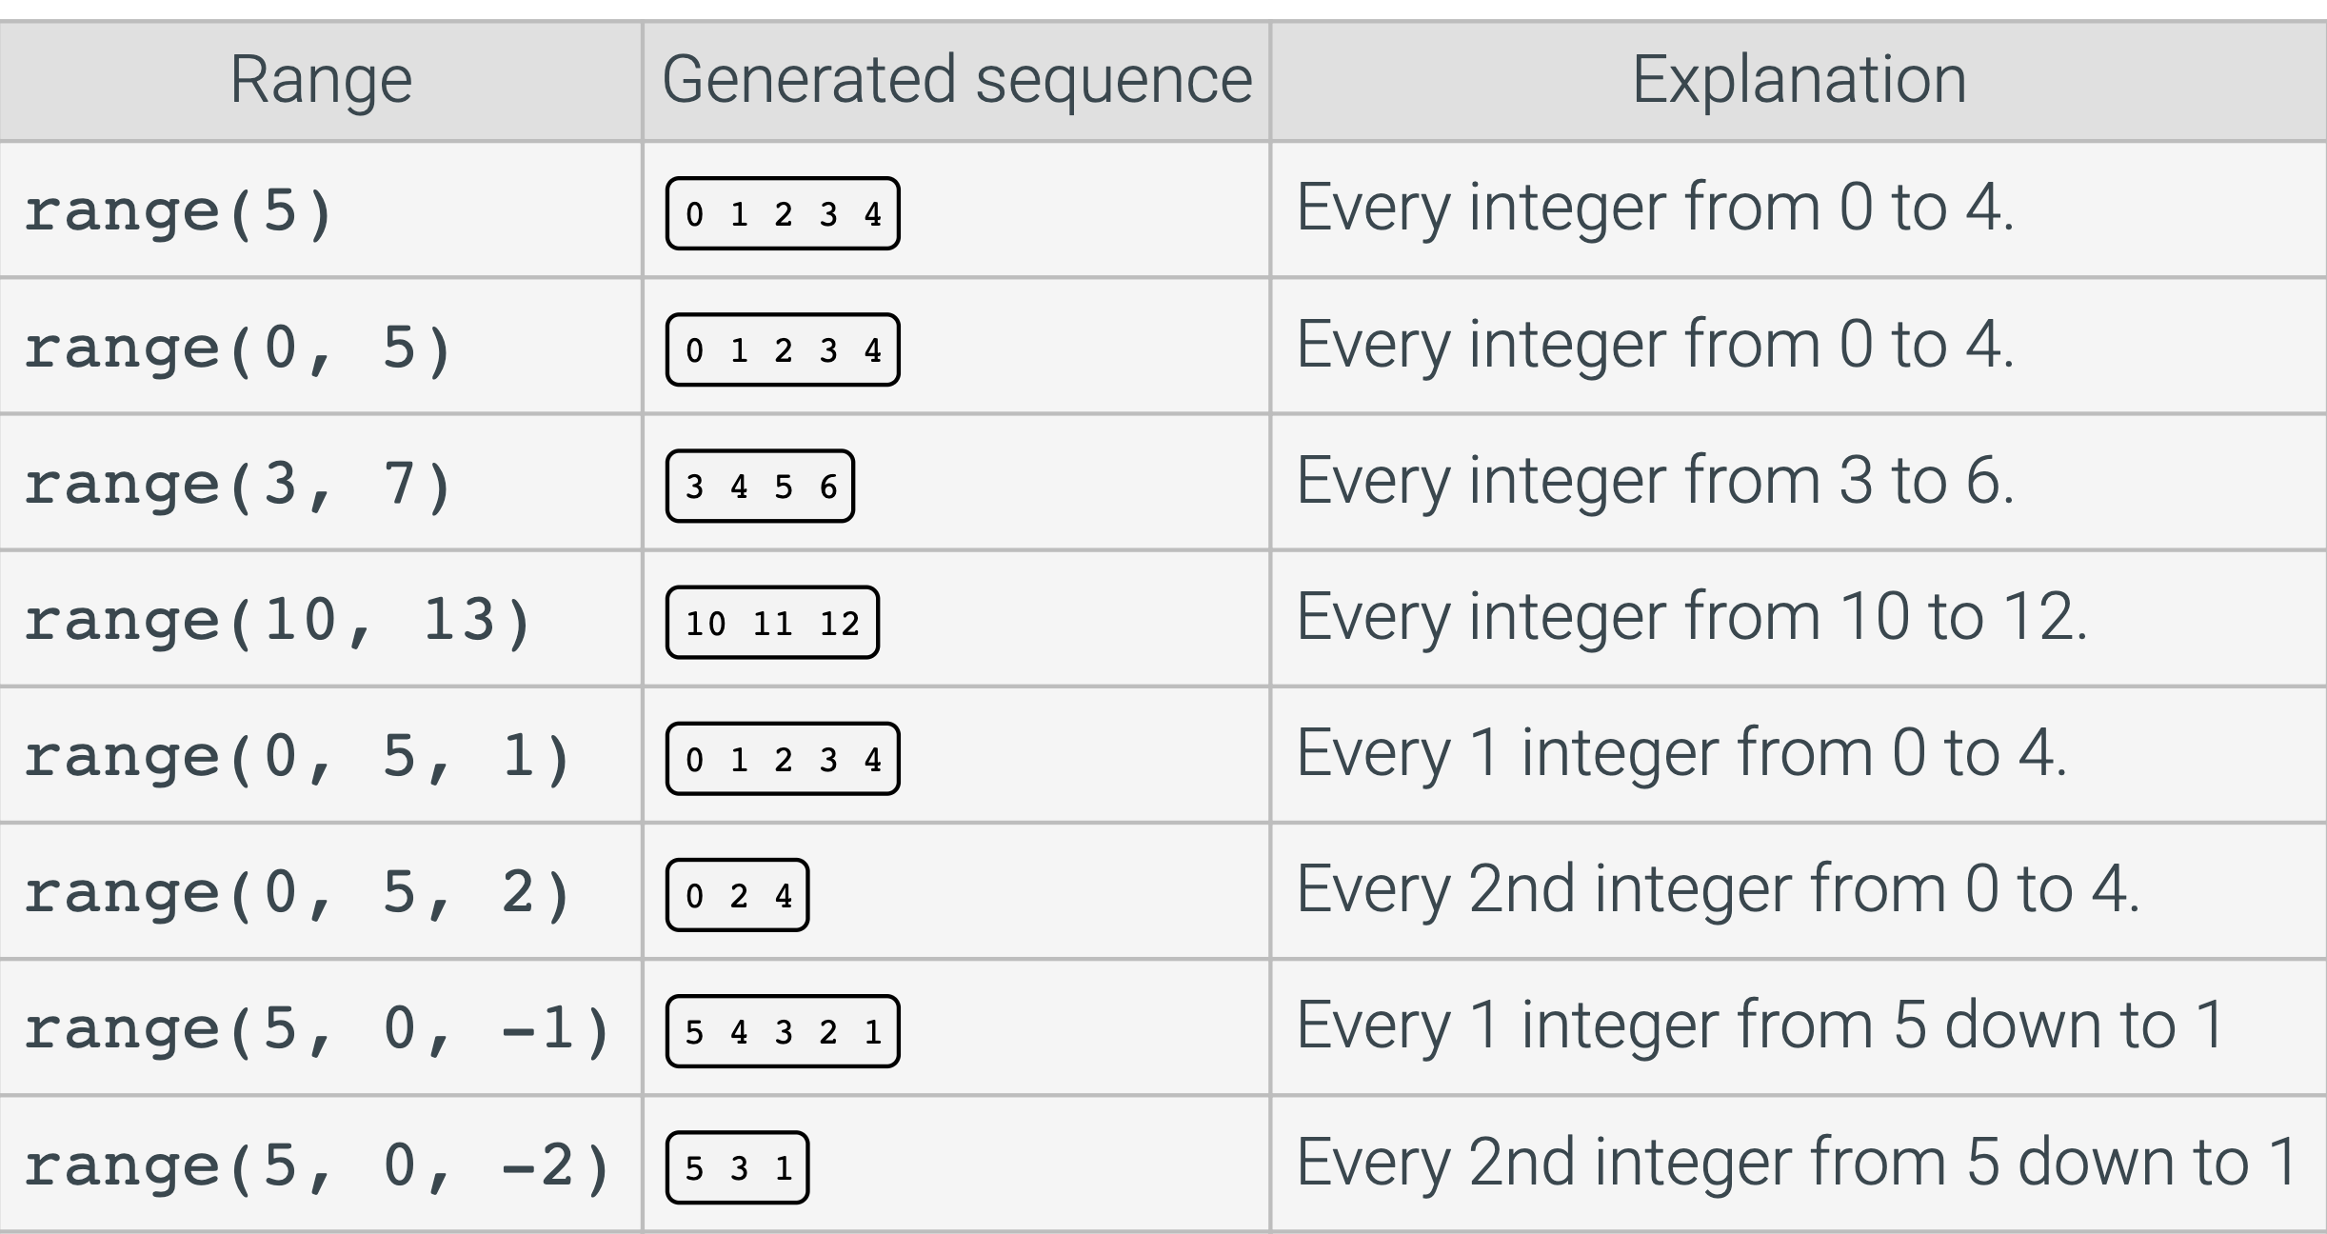

Slide 38
Counting with for and range
print('1 to 5 with range')
for x in range(1,6):
print(x)
print('5 to 1 with range')
for x in range(5,0,-1):
print(x)
1 to 5 with range
1
2
3
4
5
5 to 1 with range
5
4
3
2
1

Slide 39
for loops
print('Strings')
for x in 'Hello':
print(x)
print('List of Strings')
for x in ['Hello', 'World']:
print(x)
Strings
H
e
l
l
o
List of Strings
Hello
World

Slide 40
for loops
print('Dictionaries keys only')
my_dict={'Hello':1, 'World':2}
for x in my_dict:
print(x)
print('Dictionaries keys and values')
for x in my_dict:
print(x,my_dict[x])
print('Dictionaries values only')
for x in my_dict.values():
print(x)
print('Dictionaries (key,values)')
for x in my_dict.items():
print(x)
print('Dictionaries key values')
for x,y in my_dict.items():
print(x,y)
Dictionaries keys only
Hello
World
Dictionaries keys and values
Hello 1
World 2
Dictionaries values only
1
2
Dictionaries (key,values)
('Hello', 1)
('World', 2)
Dictionaries key,values
Hello 1
World 2

Slide 41
All while examples should be written by for loop

Slide 42
The break statement
Implements the "exit loop" primitive
Causes flow of control to leave a loop block (while or for) immediately
for i in range(1,10):
if i % 7 == 0:
break
print(i)
print('Done break')
1
2
3
4
5
6
Done break

Slide 43
The continue statement
Causes flow of control to start immediately the next iteration of a loop block (while or for)
for i in range(1,10):
if i % 7 == 0:
continue
print(i)
print('Done continue')
1
2
3
4
5
6
8
9
Done continue

Slide 44
Example : Factorization
Write a program which prints out the prime factorization of a number (treat 2 as the first prime)
For example,
on input 6, desired output is: 2 3
on input 24, " " : 2 2 2 3
" " 14, " " : 2 7
" " 23, " " : 23 (23 is prime)

Slide 45
Write a for/while loop which will produce the following output (hint: use two nested loops)
1 22 333 4444 55555

Slide 46
Input a number (int) and reverse the number

Slide 47
Input a number (int) and write the binary representation

Slide 48
Print mxn rectangle with *

Slide 49
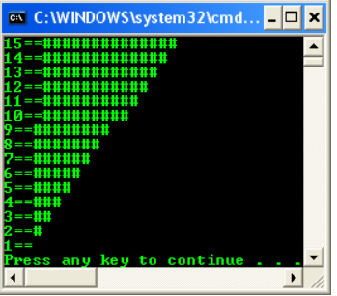
Write the program for this output

Slide 50
Getting both index and value when looping: enumerate()
Good to use when index and value required
len, range or index that gives you the position of a value can be used alternatively
But enumerate can be easier, short and handy

Slide 51
print('Iterate by len and range')
lang=['C','Java','Pyhton']
for i in range(len(lang)):
print(i,lang[i])
print('Iterate by index')
for i in lang:
print(lang.index(i),i)
print('Iterate by enumerate')
for i,e in enumerate(lang):
print(i,e)
Iterate by len and range
0 C
1 Java
2 Pyhton
Iterate by index
0 C
1 Java
2 Pyhton
Iterate by enumerate
0 C
1 Java
2 Pyhton

